Slide 1
COMP-4441 Final Project
Navan Powers & Andrew Graham

Slide 2
Research Question
Did the “Stay-at-Home” lockdown orders due to the Covid-19 outbreak affect marijuana dispensary sales in Colorado?

Slide 3
Data Sources
Marijuana Sales Data
Colorado Department of Revenue
https://cdor.colorado.gov/data-and-reports/marijuana-data/marijuana-sales-reports
January 2014 – May 2021
Covid Incidence Data
Colorado Department of Public Health & Environment
https://covid19.colorado.gov/data
March 2020 – Present
*Marijuana dispensaries were classified as part of state’s Health Care Sector and allowed to remain open during lockdown orders
Notes:
Considered essential business
No disruption in sales

Slide 4
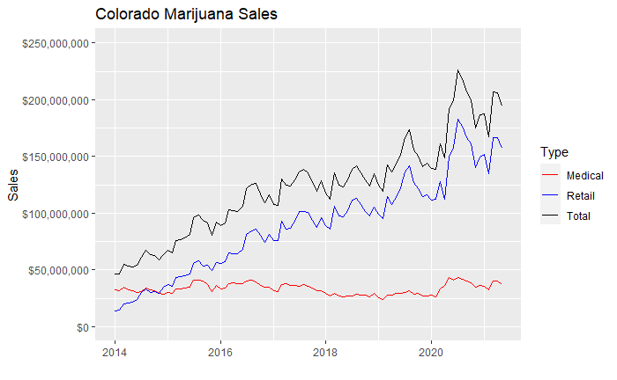
Initial Data Plot

Slide 5
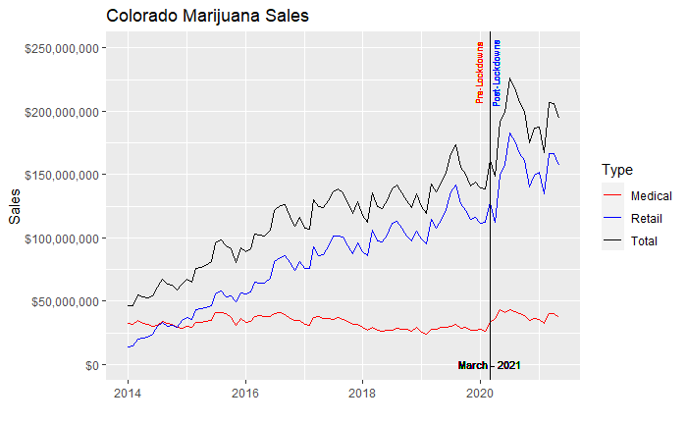
Initial Data Plot – Lockdown Marker

Slide 6
Chow Test
Used to determine if there is a structural break in data linearity between two or more regressions in split data sets
Test if a single line or separate regression lines best fit the data
Often used to analyze two different data sets to see if they can be pooled together
Commonly used in econometrics
Returns p-value indicating regression stability

Slide 7
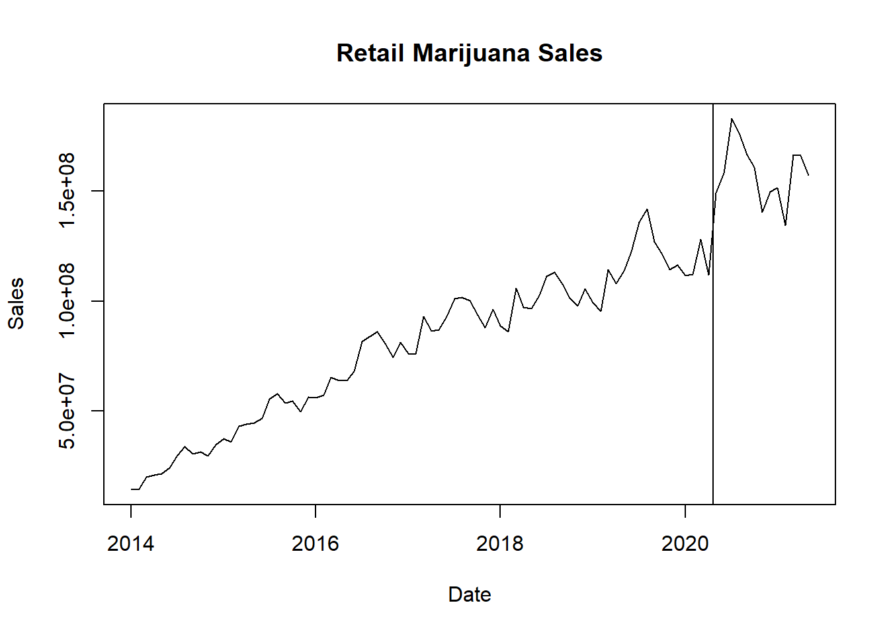
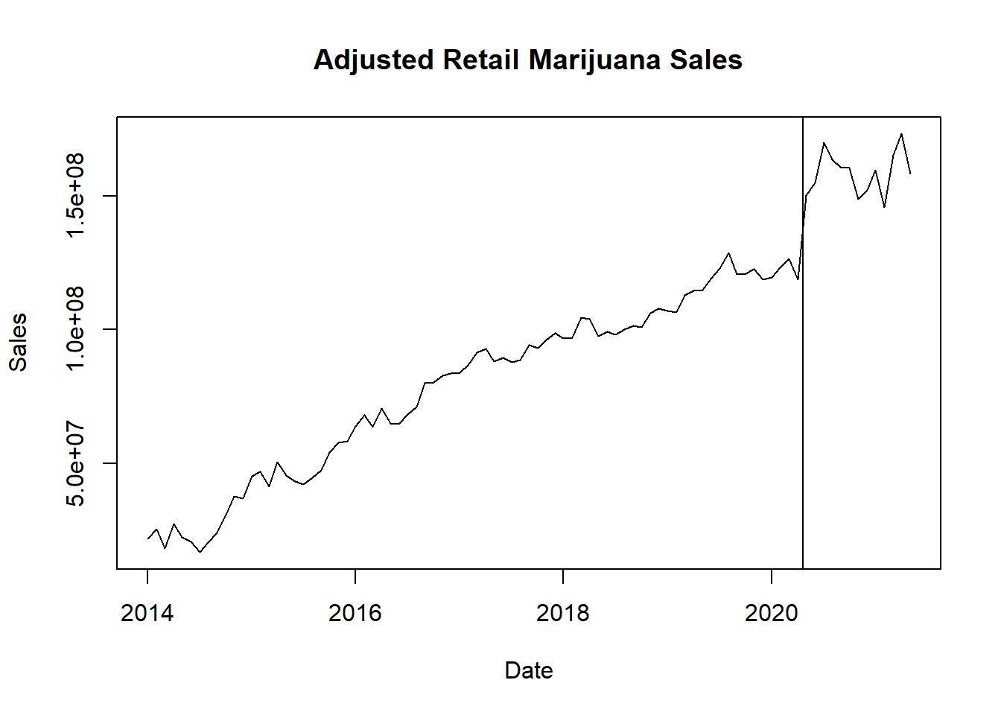

Removing Regular Fluctuation or Seasonality in Data
P-value Low: Strong Evidence that Sales Changed after breakpoint of March 2020

Slide 8
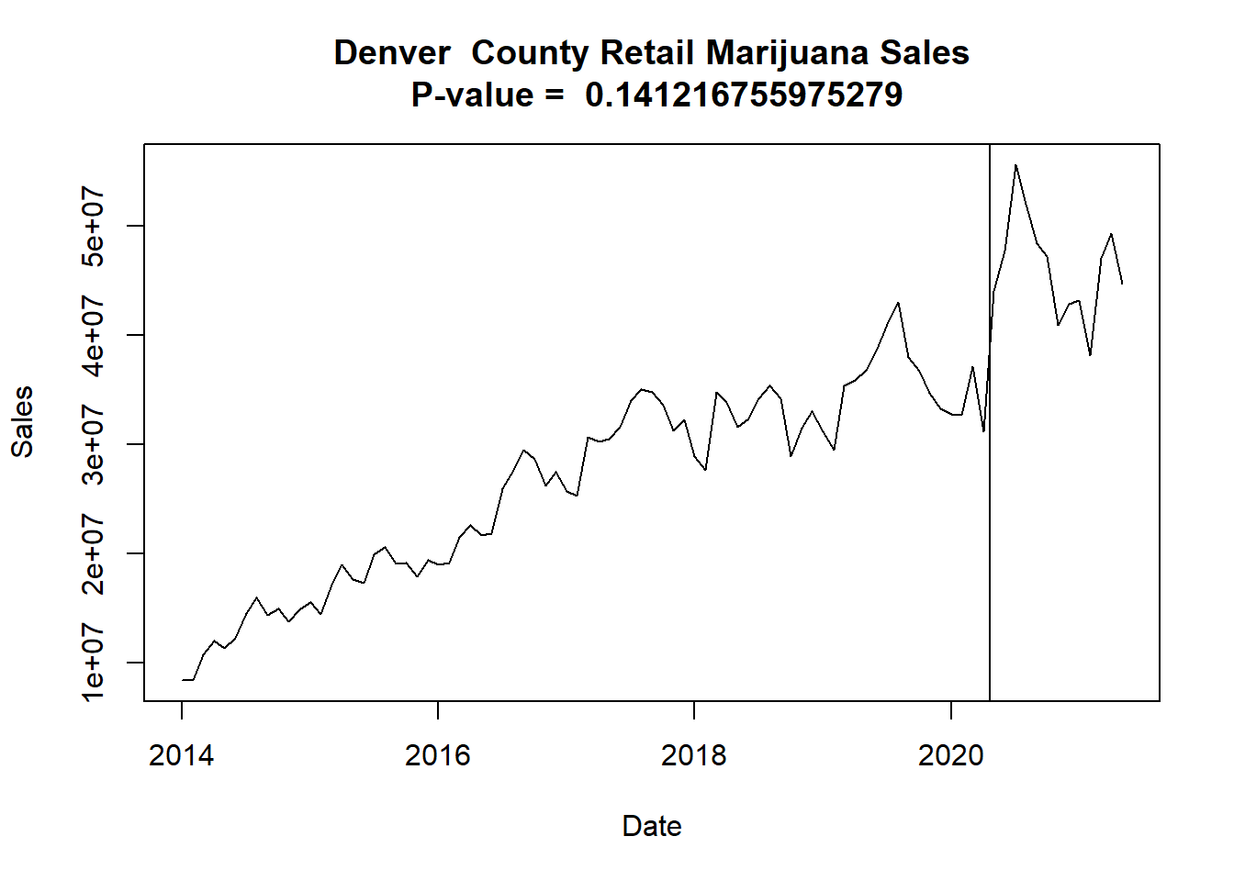
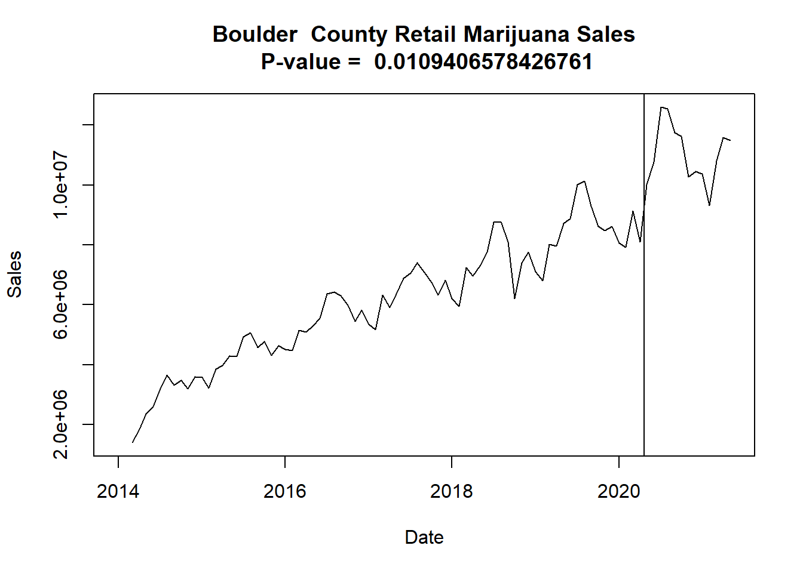
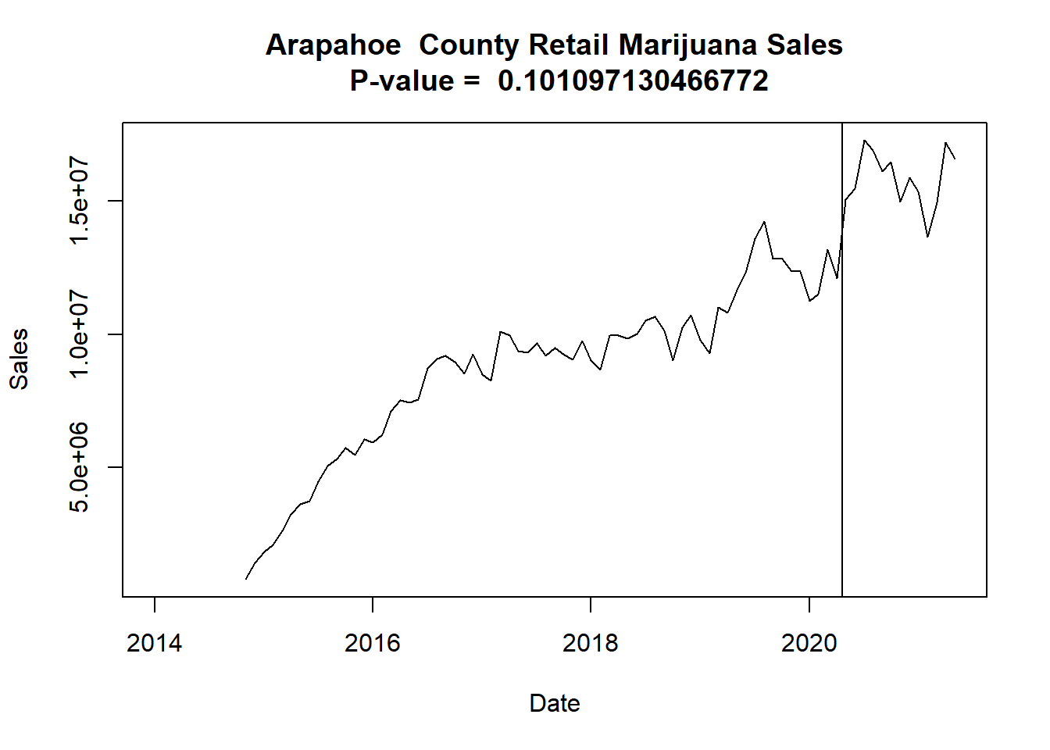
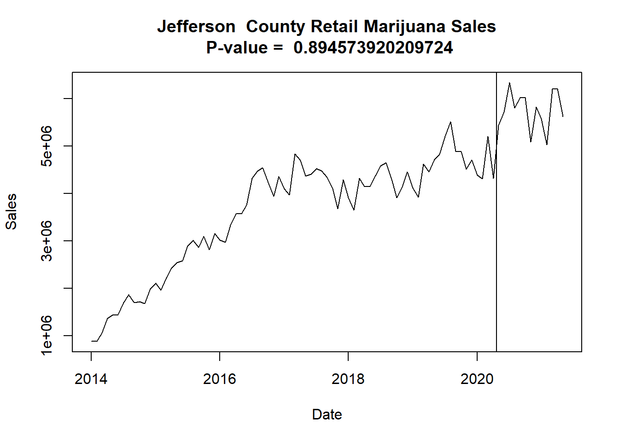
County Level Data
## County DataPoints PValue Reject_Null
## 1 Adams 77 4.810252e-11 TRUE
## 2 Arapahoe 79 1.010971e-01 FALSE
## 3 Archuleta 51 4.137149e-04 TRUE
## 4 Bent 5 NA NA
## 5 Boulder 87 1.094066e-02 TRUE
## 6 Chaffee 61 3.433096e-01 FALSE
## 7 Clear.Creek 89 7.132070e-02 FALSE
## 8 Conejos 42 2.240083e-02 TRUE
## 9 Costilla 64 2.220447e-05 TRUE
## 10 Crowley 0 NA NA
## 11 Denver 89 1.412168e-01 FALSE
## 12 Eagle 82 4.507621e-01 FALSE
## 13 El.Paso 0 NA NA
## 14 Garfield 85 2.785385e-01 FALSE
## 15 Gilpin 86 3.602572e-01 FALSE
## 16 Grand 69 7.255423e-01 FALSE
## 17 Gunnison 81 4.588904e-01 FALSE
## 18 Huerfano 26 1.008087e-01 FALSE
## 19 Jefferson 89 8.945739e-01 FALSE
## 20 Lake 45 8.549919e-02 FALSE
## 21 La.Plata 79 1.091498e-06 TRUE
## 22 Larimer 83 1.102853e-02 TRUE
## 23 Las.Animas 77 4.864853e-02 TRUE
## 24 Mesa 45 6.823595e-03 TRUE
## 25 Moffat 29 1.740382e-03 TRUE
## 26 Montezuma 76 1.074009e-01 FALSE
## 27 Montrose 0 NA NA
## 28 Morgan 52 4.277714e-04 TRUE
## 29 Otero 14 NA NA
## 30 Ouray 50 1.464512e-01 FALSE
## 31 Park 75 4.088663e-06 TRUE
## 32 Pitkin 86 1.783652e-01 FALSE
## 33 Pueblo 89 2.058353e-13 TRUE
## 34 Routt 76 1.851871e-02 TRUE
## 35 Saguache 45 2.355935e-03 TRUE
## 36 San.Juan 9 NA NA
## 37 San.Miguel 88 8.964043e-01 FALSE
## 38 Sedgwick 8 NA NA
## 39 Summit 89 1.240698e-01 FALSE
## 40 Weld 86 7.515368e-01 FALSE
14 Counties show evidence of increased Marijuana Sales after March 2020

Slide 9
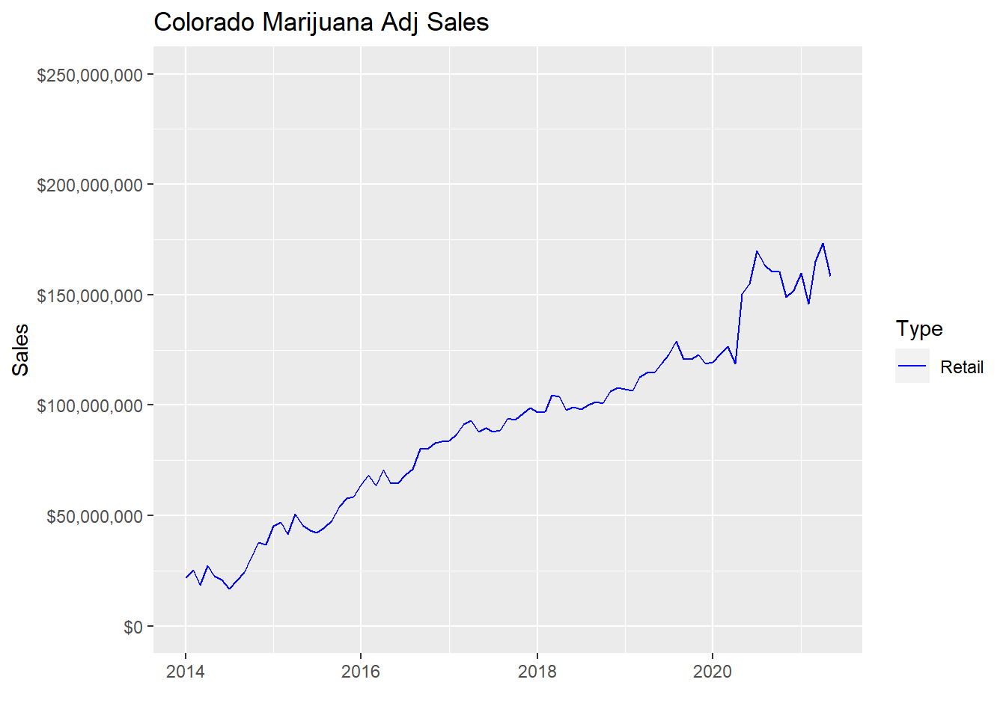
Adjusted Retail Sales
Notes:
To validate and give a visual to our Chow Test results, we plotted a linear model to our two groups of data separated by the lockdown point
Looking back at our Adjusted Retail Sales data

Slide 10
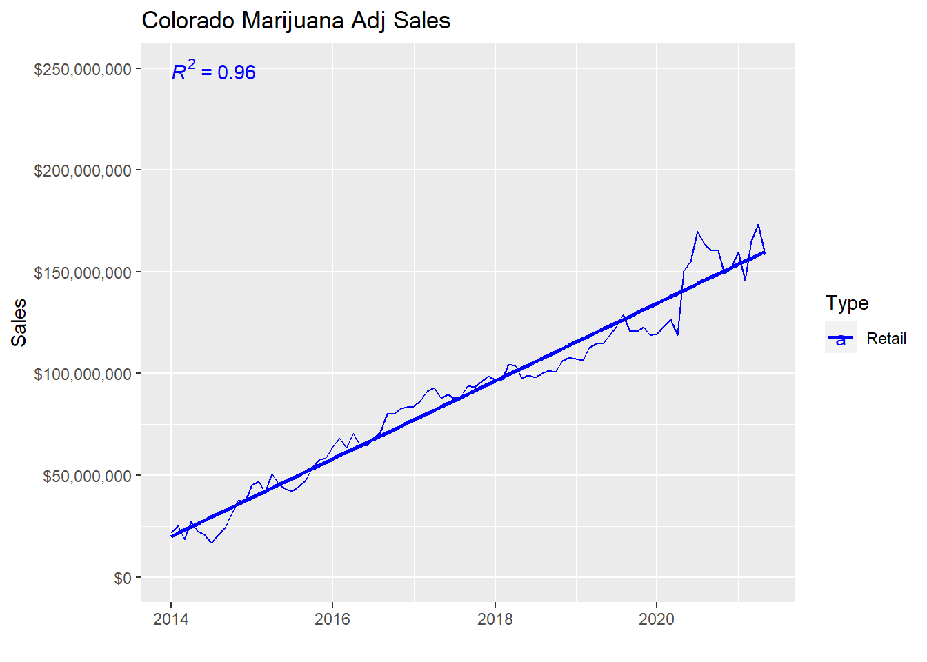
Linear Model over Retail Sales
Intercept: -820223093
Slope: 52281.5
Notes:
Here is the single linear model over the whole time period
*The intercept is so large because R stores date objects as numeric values for computation purposes

Slide 11
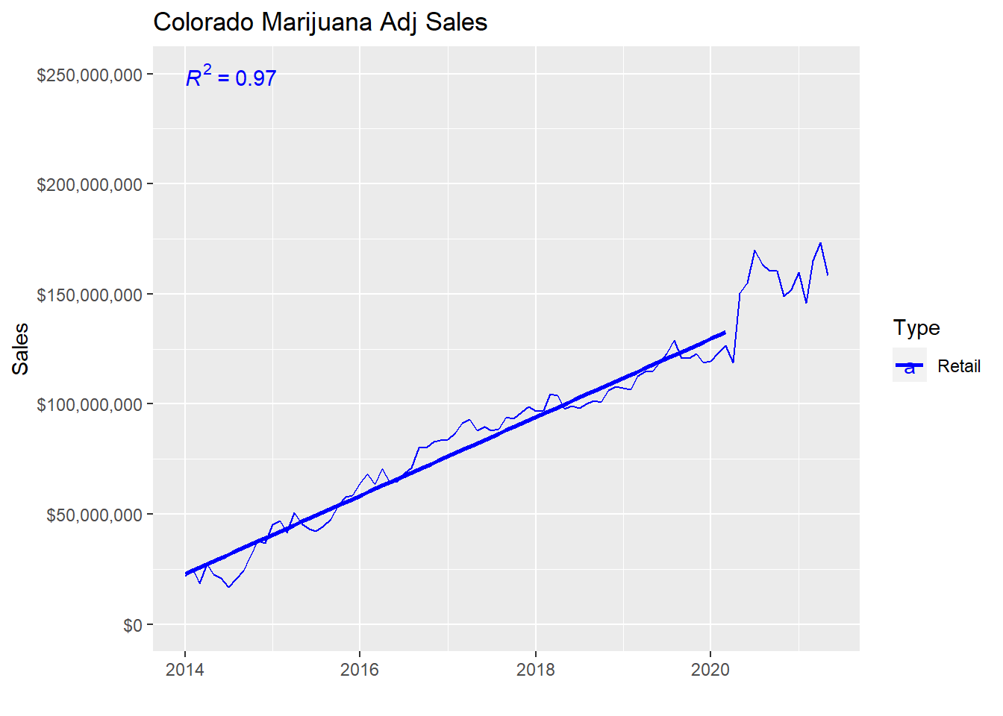
Linear Model over Retail Sales – Pre Lockdown
Intercept: -764228325
Slope: 448963.47
Notes:
So, now breaking our data into pre and post lockdown time periods we can show the different regression lines for each.
Here is our pre period with the associated coefficient values

Slide 12
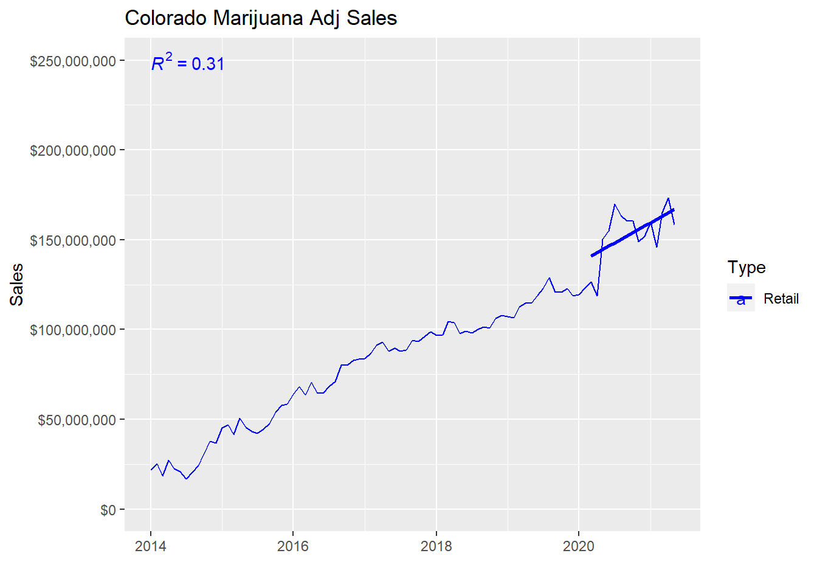
Linear Model over Retail Sales – Post Lockdown
Intercept: -977204478
Slope: 61020.1
Notes:
And here is our post period with the associated coefficient values.
We can see from the coefficient values that there is a definite difference in the trends

Slide 13
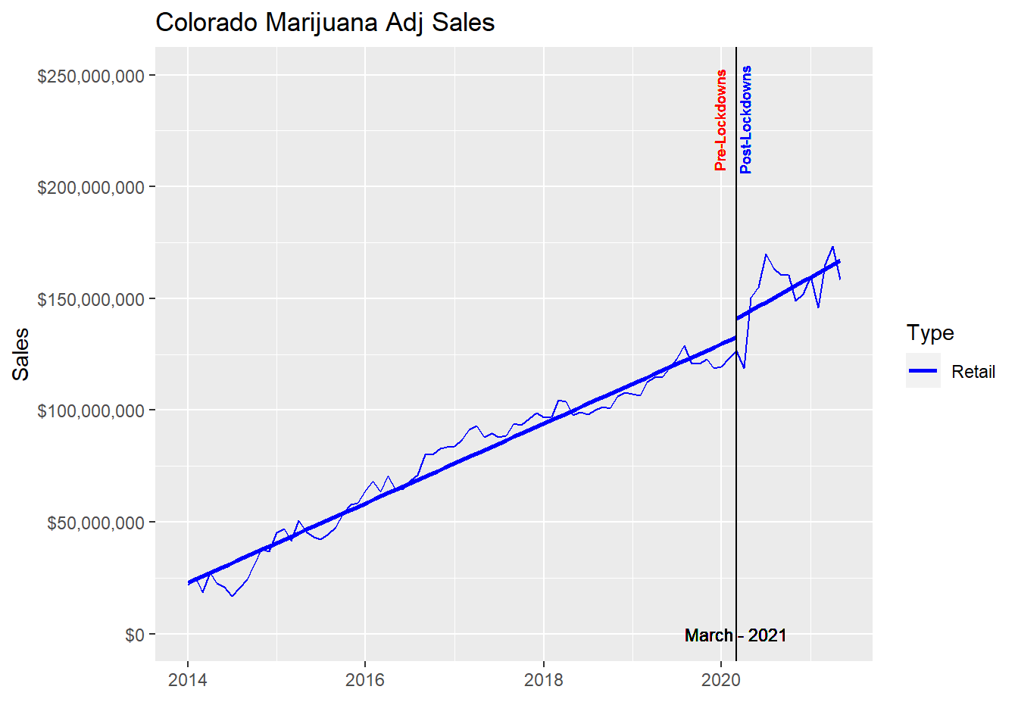
Combined Linear Models over Retail Sales
Notes:
And both trends on our sales data with lockdown time marker.
Along with the numerical coefficient differences, it is easy to tell from the sales plot with the trend lines that there was a trend shift at the point of significance.
Since we had the reported covid case data, we decided to see how those data compared to the sales numbers, too

Slide 14
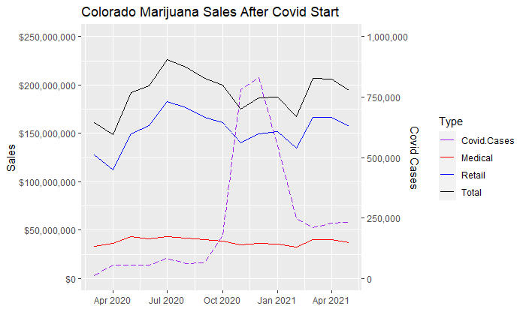
Retail Sales and Covid Cases
Notes:
This plot shows the Covid and sales numbers after the pandemic began.
There did not appear to be a visual correlation

Slide 15
Conclusions
Evidence of change in marijuana sales trend before and after Covid-19 lockdowns at the Colorado Level
On a county level, sales trends varied
Lockdowns showed more of an impact on marijuana sales than Covid-19 cases
Further research could be done at a county level
Notes:
There did appear to be a positive change in marijuana sales on a state level from the covid stay at home lockdowns
While not every county showed an increase of marijuana sales, highly populated counties had significant increases resulting in the state wide trend
When comparing the lockdowns and cases of covid to marijuana sales, data suggests that the lockdowns showed more of a relation to sales increases than covid
And lastly:
Further research could be done at a county level to investigate what factors led to increased sales after lockdown orders were issued

Slide 16

Questions

Slide 17
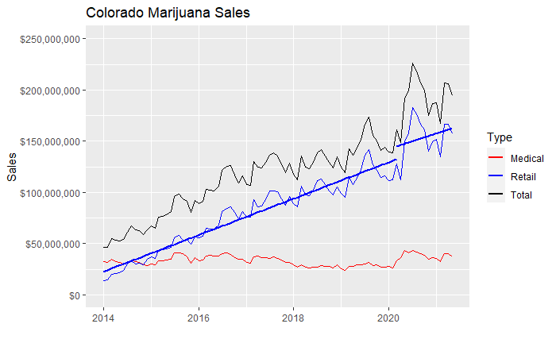
Combined Linear Models over Retail Sales

